Slide 1
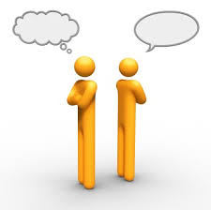
Difficult Conversations
with Ernie Mendes, Ph.D.
760-994-8880
erniemendes.com

Slide 2
S + R = E

Slide 3
*Internal Dialogue
*Mental Imagery
*Behavior

Slide 4
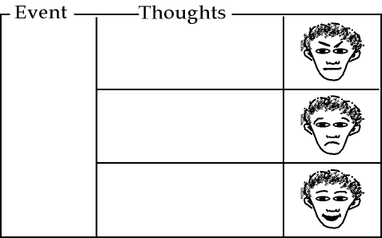

Slide 5
“That was my spot! I was here first! That’s so rude!”
He’s such a #$@!%&*”
You are waiting for a parking spot. Someone sees you but takes that spot when it opens.
“This always happens to me. I should have gotten here earlier. It’s going to be one of those days.”
“I guess he needed it more than I did. Just let him have it. It’s not worth it. I’ll find another one.”

Slide 6
Mindful Responding
Stop
Take a slow deep breath
Observe/reflect
Proceed

Slide 7
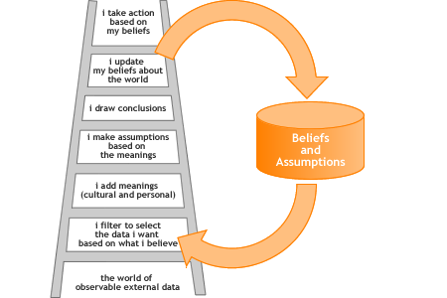
The Ladder of Inference
(Chris Argyris, Harvard Business School)

Slide 8
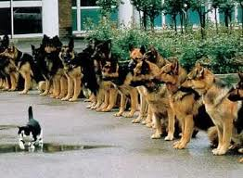

Slide 9
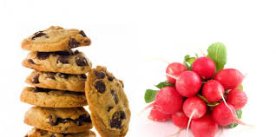


Slide 10
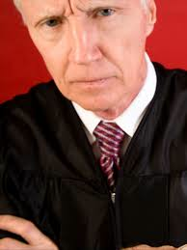
Decision fatigue
Before lunch 10-15% After lunch 66%

Slide 11
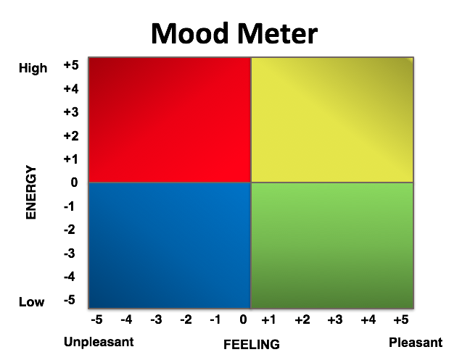
(Marc Brackett, Yale University)

Slide 12
Mood Meter
Where are you on the mood meter?
*What word best describes your current feeling?
*What caused you to feel this way?
How are you expressing that feeling?
*Given how you feel what strategy will you use to get the most out of our time?

Slide 13
•Persuasive Speaking
•Brainstorm
Determined Mindset
Flexible Mindset
•Proofing & Editing
•Building Consensus
Critical Mindset
Reflective Mindset

Slide 14
Recognize & Regulate

Slide 15
Study of 130 executives
Found that how well people handled their own emotions determined how much people around them preferred to deal with them (Walter V. Clarke Associates).

Slide 16
Center for Creative Leadership
Primary causes of derailment in executives were deficits in emotional competence Top three were:
Difficulty in handling change
Not being able to work well on a team
Poor interpersonal relations

Slide 17
They’re contagious
They leak
They drive behavior

Slide 18
Emotions Influence
Attention, Memory, & Learning (Compton, 2003)
Decision-Making & Judgment (Damasio,1994)
Relationship Quality (Gottman, 1982, Brackett et al., 2005, 2006)
Physical & Mental Health (Brackett, et al., 2006, Ciarrochi, et al., 2000)

Slide 19
Self-assessment
What makes a conversation “challenging” for me is_______________________
What I do well in difficult conversations is_______________________
Triggers that push my buttons are___________________
What I’ve seen others do well in tough conversations that I would like to do is_____________________

Slide 20
BIG IDEAS
set Context
listen to Understand
express Yourself
solve Problem
manage Emotions
follow-Up

Slide 21
Set the Context
In the big picture, why is this conversation important to have?
What’s likely to happen if you don’t have it? or do have it?
Know your outcome/objective for the conversation
Set an expectation for the conversation prior
Opening statement reinforces it

Slide 22
Prepare an opening line
“I’d like to hear your thoughts on this problem and to express my own. Then I think we should take some time to problem-solve. How does that sound to you?”

Slide 23

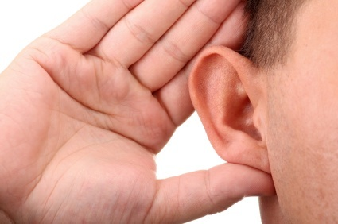
Listen to Understand
Listen to understand
Ask clarifying questions
Summarize occasionally
Breathe

Slide 24
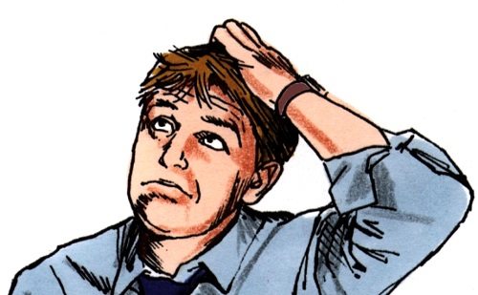


Difficult Conversations
The “What Happened?” conversation
The “Feeling” conversation
The “Identity” conversation

Slide 25

What Happened?
“I think I’m right”
We apply different rules
Our conclusions support self-interest
Move from certainty to curiosity
Use the “and” stance

Slide 26
.....what happened:
Don’t assume they meant it
Assumptions about intentions are often wrong
We assume intentions from the impact on us (hurt, slighted)
We assume the worst and see ourselves as more charitable

Slide 27

...what happened
Avoid Blame ---Focus on Contribution
Costs of blame
Benefits of contribution
Role reversal or third position observation

Slide 28
The Feeling Conversation:
Know Your ‘Emotional Footprint’
Judgments: “If you were a good friend you would have been there for me”
Attributions: “Why were you trying to hurt me?”
Characteristics: “You’re just so inconsiderate”
Problem-solving: “The answer is for you to call me more often”

Slide 29
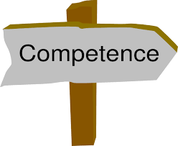

The Identity Conversation
Difficult conversations threaten our identity
“Am I competent?”
“Am I a good person?”

Slide 30
...identity conversations
The “ALL or Nothing Syndrome”
Exaggeration
Denial
Use the “AND Stance”

Slide 31
Reflections
Which of these three conversations are you most aware of in your challenging conversations?

Slide 32
Express yourself
I noticed... and I was wondering (thinking/feeling)....

Slide 33
Situation (I noticed...)
Input (What happened?)
Summarize (So, you...)
Impact (As a result...)
Request (We need to...Would you be willing to...?)

Slide 34
When I saw/heard...(observation)
I felt...(emotion)
because... (reason- value/need)
What would work best for me is...(request)
Does that work for you...?(agreement)

Slide 35
My intention IS NOT to...
My intention IS TO...
I don’t want...
I do want...

Slide 36
Collaborative Phrases
Mark, I need your help with this...
Help me understand your thinking about...
That’s interesting tell me more. What’s your thinking behind that?
What if we...?

Slide 37
Solve the problem
Brainstorm ideas
Suggest viable solutions
Probe for clarity
What do you mean by...?
What would it look like if...?

Slide 38
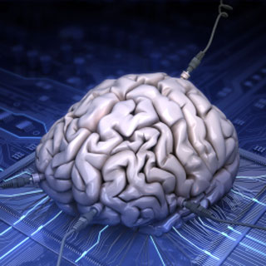
Operating Beliefs
Everything Speaks
People are doing the best they can given their current level of awareness and resources
We teach others how to treat us
People act on their perceptions
The meaning of your communication is the response you get

Slide 39


Closure
List 3 ideas that resonated with you the most.___________________________________________________________________________________________________________________________
Based on your learnings from today, what is one thing you will STOP doing and one thing you will START doing?______________________________________________________________________________________________

Slide 40
Further Reading, EMOTIONS RESEARCH:
The Emotional Life of Your Brain by Richard J. Davidson, Ph.D. with Sharon Begley
Positivity by Barbara L. Fredrickson, Ph.D.
Molecules of Emotion by Candace B. Pert, Ph.D.
Descartes’ Error by Antonio R. Damasio
The Emotional Brain by Joseph LeDoux

Slide 41
Further Reading: CONVERSATIONS
Getting to Yes by Roger Fisher & William Ury
Beyond Reason by Roger Fisher & Daniel Shapiro
Crucial Conversations by Patterson, Grenny, McMillan, Switzler

Slide 42
Further Reading, LEADERSHIP:
Primal Leadership by Daniel Goleman, Richard Boyatzis and Annie McKee
The Emotionally Intelligent Manager by David R. Caruso and Peter Salovey
Multipliers: How the Best Leaders Make Everyone Smarter by Liz Wiseman with Greg McKeown
Your Brain at Work by David Rock
Switch by Chip Heath and Dan Heath

Slide 43
Contact info.
Ernie Mendes
email: emendes@erniemendes.com
website: erniemendes.com
phone: 760-994-8880

